Slide 1

Introduction to this Program
This program is to explore how to use most of AI effectively and securely
This is done through AI literacy which is understanding and confidence in using AI tools
By the end of program:
Understand what AI actually is
Recognise what AI can and can’t do
Use AI tools responsibly and securely
Integrate AI into your own workflows to amplify yourself in that space

Slide 2
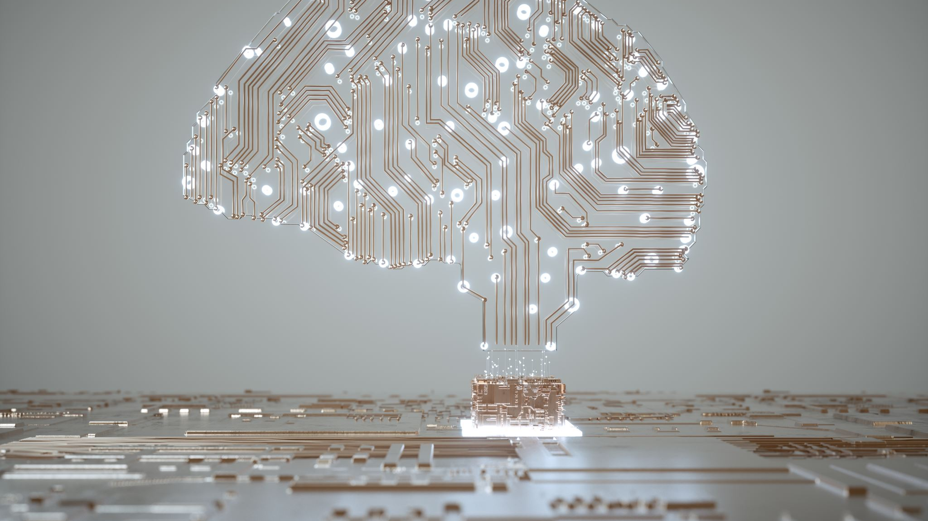
What is Artificial Intelligence?
Session 1

Slide 3
Learning Objectives for Session 1
Understand what Artificial Intelligence is on a general level
1
Understand how AI conceptually learns and outputs
2
See how AI can work in everyday life and work
3

Slide 4
Why is Everyone talking about AI?
AI is not new and has been around for decades
AI tools are now drastically more accessible.
This technology is powerful and is shaping how we communicate and work
AI is still growing and is driving the next big revolution
Learning how to use AI = staying relevant and shaping your future

Slide 5
What is AI?
Able to perform tasks that would require human intelligence:
Problem-Solving
Pattern recognition
Learning from outcomes
Decision-making with reasoning
Systems that simulate aspects of human thinking via automation and data
AI is a field in computer science, that has various forms of technology from it.

Slide 6


AI vs Traditional Programs
Traditional Programs are like cooking recipe books
Contains set instructions
Cannot change
Always produce the same results
AI is like the chef
Is dynamic and can change
Makes the changes by observing the result
Makes changes based on experience

Slide 7
Types of AI
Narrow AI
Designed to perform a specific task, excels within its limits
Cannot generalise beyond its specific task
This is the type we have currently e.g. Siri, Netflix recommendation, ChatGPT.
General AI
Able to understand, learn and apply information in various tasks
Comparable to human intelligence and can respond like one
This is purely theoretical for now
Do not have the misconception that current AI has reached this level
Current AI is LIMITED to its task design

Slide 8
How AI learns – Machine Learning
Teaching a child about dogs & cats
Show examples of dogs and cats
Highlight distinctions for child
Child then learns from such patterns over time
Similarly, AI learns with Machine learning
Utilises large datasets for different areas
Makes predictions and alters internal parameters based on accuracy
Repeats to improve prediction

Slide 9
How AI learns
Supervised learning
Using labelled data to make accurate predictions on new unseen data
AI learns to associate specific features with the correct label
Unsupervised Learning
Using unlabelled data to find inherent patterns or associations in data
Reads through data and reveals potential structures within
Reinforcement Learning
AI agent learns through trial and error, rewarded if right and penalty if wrong
learns actions needed for cumulative rewards
All methods utilise pattern recognition
AI does not actually understand but rather responds using the recognition of patterns developed over their learning

Slide 10

Real world AI-Applications

Slide 11
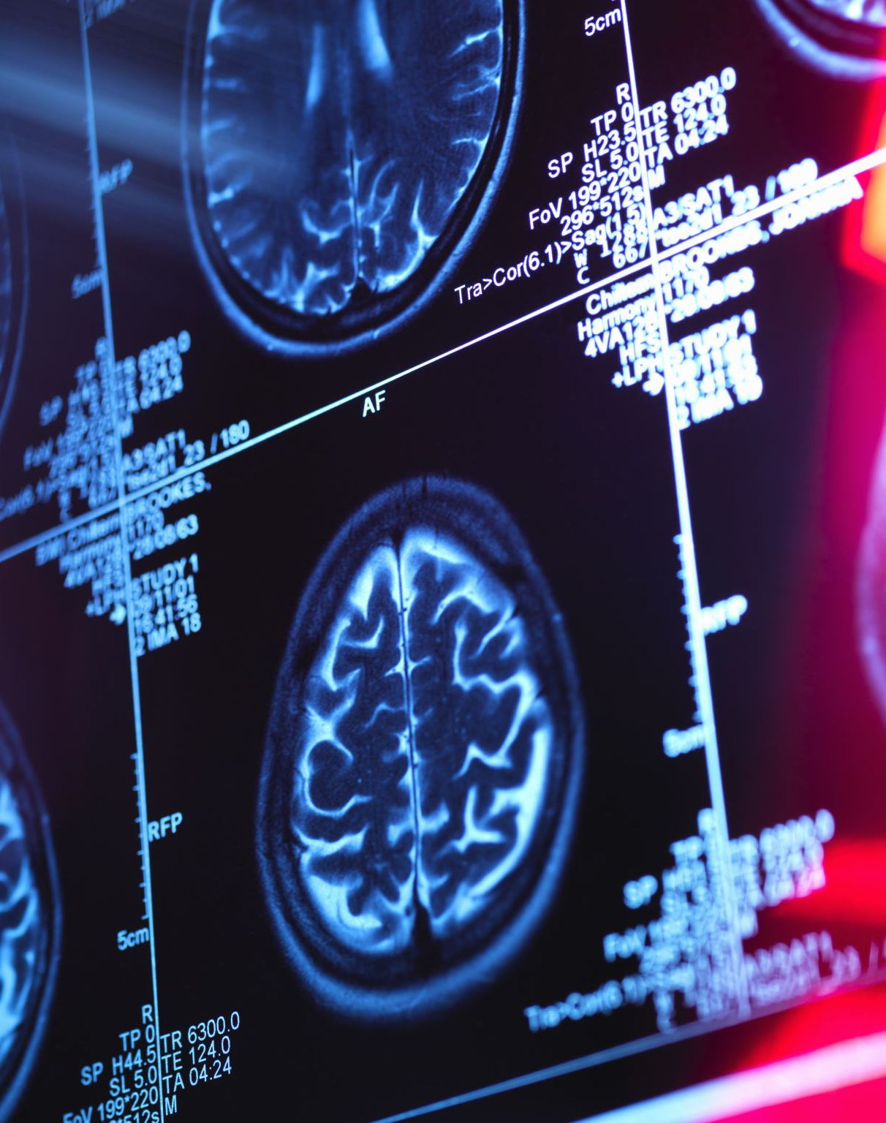
AI in healthcare
Clinical Diagnosis: AI analyzes medical images (X-rays, CT/MRI scans) to highlight potential diseases or areas of concern for doctors.
Patient Management: Processes vast amounts of patient data to track vital signs, generate summaries, and suggest personalized treatment options.
Administrative Efficiency: Automates non-clinical tasks like scheduling appointments, managing records, and handling insurance claims.
Impact: Enables better patient care while maintaining efficiency in high-demand environments.

Slide 12

AI in education
Personalized Learning: Intelligent tutoring systems adapt to individual student pace and style, offering customized exercises and feedback.
Teacher Support: Assists educators in generating assessments, grading assignments, and creating lesson plans.
Performance Analytics: AI-powered systems identify early trends in student performance, allowing for timely, targeted intervention and support.
Impact: Enhances both administrative efficiency and overall student learning outcomes.

Slide 13

AI in Businesses
Strategic Decision Support: Analyses large datasets to generate actionable insights on market trends, customer behaviour, and operational performance.
Marketing & Content: Accelerates workflows by drafting emails, summarizing reports, and generating consistent content for social media campaigns.
Customer Engagement (Frontline): AI-driven chatbots and virtual assistants handle rapid responses to common inquiries.
Human Augmentation: Frees up human staff to focus on complex issues that require critical thinking and empathy.

Slide 14
Importance of AI literacy
Hence, professionals that can interact with AI tools innovate their roles
They can identify efficiency gains
Make data-informed decisions
Through AI, human capabilities can be extended across different sectors

Slide 15
Summary
AI's Foundation: AI systems learn from data and identify patterns (using methods like Supervised, Unsupervised, and Reinforcement Learning) to make predictions.
The Learning Distinction: Crucially, AI generalizes from data by detecting patterns, not by understanding—human judgment remains essential.
Core of Literacy: It's about knowing not only what AI is, but how to confidently integrate it to enhance human productivity, creativity, and decision-making.
AI as Augmentation: AI is a powerful tool designed to augment human intelligence, extending capabilities across diverse professional environments.
Next Steps: Professionals must be familiar with the strengths and limitations of AI when utilising AI tools

Slide 16

How AI learns : Shape-to-colour activity
Please refer to the activity 1.1 instruction sheet

Slide 17

Comparison Test Activity
Please see activity 1.2 instruction sheet

